Slide 1


Distributed Computing frameworks
From MapReduce to computation graph to distributed training
SE3331-1 (2023 Fall)
Xingda Wei, Yubin Xia
IPADS, Shanghai Jiao Tong University
https://www.sjtu.edu.cn
Credits: Rong Chen@IPADS, CMU15-418

Slide 2
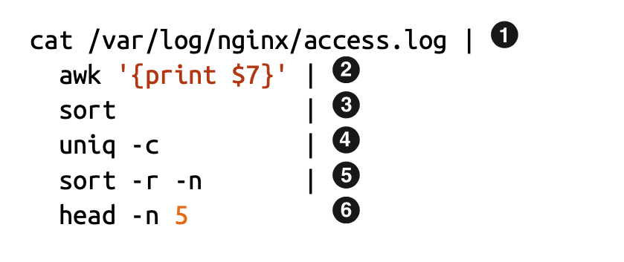
Review: simple command-line solution doesn’t scale
Example: log processing
  Process large data
  Many computations can be paralleled processed

Slide 3
Review: process to distributed computing
A large problem to solve, e.g., log processing, AI training
Decompose
Sub-problems. Many alias, e.g., sub-tasks, sub-jobs (or simply jobs)
Assignment
A set of physical programs that can run on parallel units, e.g., a thread or a GPU kernel
Runtime Orchestration (or scheduling)

Slide 4
Recall, common challenges of Distributed Computing
Sending data to/from nodes
Coordinating among nodes
Recovering from node failure
Optimizing for locality
Partition the data to enable more parallelism
Same for
all problems

Slide 5
Review: we build a framework to hide the above tasks
Goal
  Reduce programmer’s effort in solving the above challenges
Challenges
  What are the abstraction? Thread & RPC is insufficient
  More general, harder to provide the above property
  E.g., if a thread fails, how can we know its progress?
    It’s a very hard problem, we will come back to it later

Slide 6
MapReduce: a distributed batch processing system
Created by Google (OSDI’04)
  Jeffrey Dean and Sanjay Ghemawat
Inspired by LISP (function language)
  Map (function, set of values)
    Applies function to each value in the set
  Reduce (function, set of values)
    Combines all the values using a function (e.g., +)
      (map #‘length’ (() (a) (a b) (a b c))) → (0 1 2 3)
      (reduce #‘+’ (1 2 3 4 5)) → 15

Slide 7
Map & Reduce is slightly different in MapReduce
Map(input) -> [k,v]
  No f: the f is inside the Map itself (no high order function)
  A map is the same within the lifecycle of a MapReduce calculation
Reduce(k, values)
  Reduce on different keys can do parallelly

Slide 8
Review: The Complete Picture of MapReduce
Client
Master
assign
tasks
Shard 0
Map
Worker
IF
Shard 1
Shard 2
Reduce
Worker
Output
File 1
M items
Shard 3
Map
Worker
IF
R items
...
Reduce
Worker
Output
File 2
Shard M-2
Shard M-1
Map
Worker
IF
Input
Files
Map Workers
Intermediate Files
Reduce Workers
Output
Files
Notes:
具体到实现，以文件作为input

Slide 9
Recall, common challenges of Distributed Computing
Sending data to/from nodes
Coordinating among nodes
Recovering from node failure
Optimizing for locality
Partition the data to enable more parallelism
How does MapReduce handle these challenges?
Same for
all problems

Slide 10
Fault tolerance of MapReduce
Machine failures are common in datacenters
  A MapReduce job can possibly run on thousands of machines
MapReduce simplifies fault tolerance due to the following two choices:
  Programming model simplifies fault recovery
    e.g., no side-effect: a map or a reduce can simply re-execute the computation to recover from failures
  Builds on a reliable service (i.e., GFS)

Slide 11
Fault tolerance of MapReduce
Worker failure
  Master pings each worker periodically via heartbeat
  If no response is received within a certain time (timeout), the worker is marked as failed
  Map or reduce tasks given to this worker are reset back to the initial state and rescheduled for other worker (re-execution)
  Robust: lost 1,600 of 1,800 machines once, but finished fine
Question: why no side-effect?
  Simplify ensuring correctness

Slide 12
Fault tolerance of MapReduce
Master failure
  Can we re-execute?
  Master’s state is persisted to GFS
  Recover master from GFS and continue
For each mapper & reducer
  Executing state: idle, in-progress or completed
  Locations of intermediate files
The state is checkpointed to GFS for fault tolerance
  Yet, master is unlikely to fail, since there is only one!

Slide 13
Fault tolerance of MapReduce
Skipping Bad Records
  Map/Reduce functions sometimes fail for some inputs
  Best solution is to debug & fix, but not always possible
  On segmentation fault:
    Send UDP packet to master from signal handler
    Include sequence number of record being processed
  If master sees two failures for same record:
    Next worker is told to skip the record
Effect: Can work around bugs in third-party libraries

Slide 14
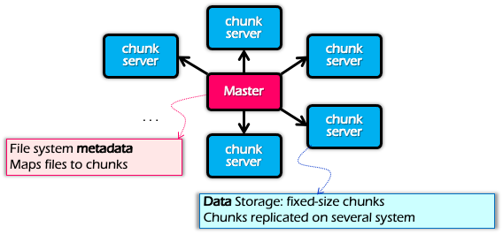
Optimization for Locality
Problem: the bandwidth of datacenter network (even today) is scarce
  If a Map worker reads all the data from the network, it would be slow
Google: Input and Output files are stored on GFS
  Google File System (SOSP’03), see previous lectures
  Each chunk is replicated on multiple servers (3)
A review of GFS architecture

Slide 15
Optimization for Locality
Problem: the bandwidth of datacenter network (even today) is scarce
  If a Map worker reads all the data from the network, it would be slow
Google: Input and Output files are stored on GFS
  Google File System (SOSP’03), see previous lectures
  Each chunk is replicated on multiple servers (3)
MapReduce runs on GFS chunkservers
  Collocate computation and storage
Master tries to schedule map workers on one of the nodes that has a copy of the input chunk it needs
  A case of system co-design

Slide 16
Refinement: redundant execution
Some workers can be slower than others, aka, stragglers
  Other jobs consuming resources on machine
  Bad disks with soft errors transfer data slowly
  Weird things: processor caches disabled ☹
Near end of phase, MapReduce spawn backup copies of tasks
  Whichever one finishes first “wins” ☺
  Dramatically shortens job completion time:“significantly reduces the time to complete large MapReduce operations ”(check the paper)

Slide 17
Summary of MapReduce
Get a lot of data from input files
Map
  Parse & extract items of interest
Partition & Sort
Reduce
  Aggregate results
Write results to output files
All the other issues, scheduling, fault-tolerance, data partitioning, are handled by the framework

Slide 18
Summary of MapReduce
The user does not need to care concurrency, fault-tolerant, data transfer, etc.
Reduce the user code burden and quality:
  Sort: only needs 50 LoC
  Indexing: reduce the code lines from 3800 LoC to 700LoC

Slide 19
Summary of MapReduce
MapReduce
Single device computing
Pros:
  Easy to scale
  Fault tolerant
  Good performance (depends!)
    Good for tasks that suits MapReduce, e.g., wordcount
Cons
  Limited programming abstraction
Scalability
Ease of
programming
Performance
Consistency
Fault tolerance

Slide 20
Question: is a scale system (like MapReduce) always better than a traditional system?

Slide 21
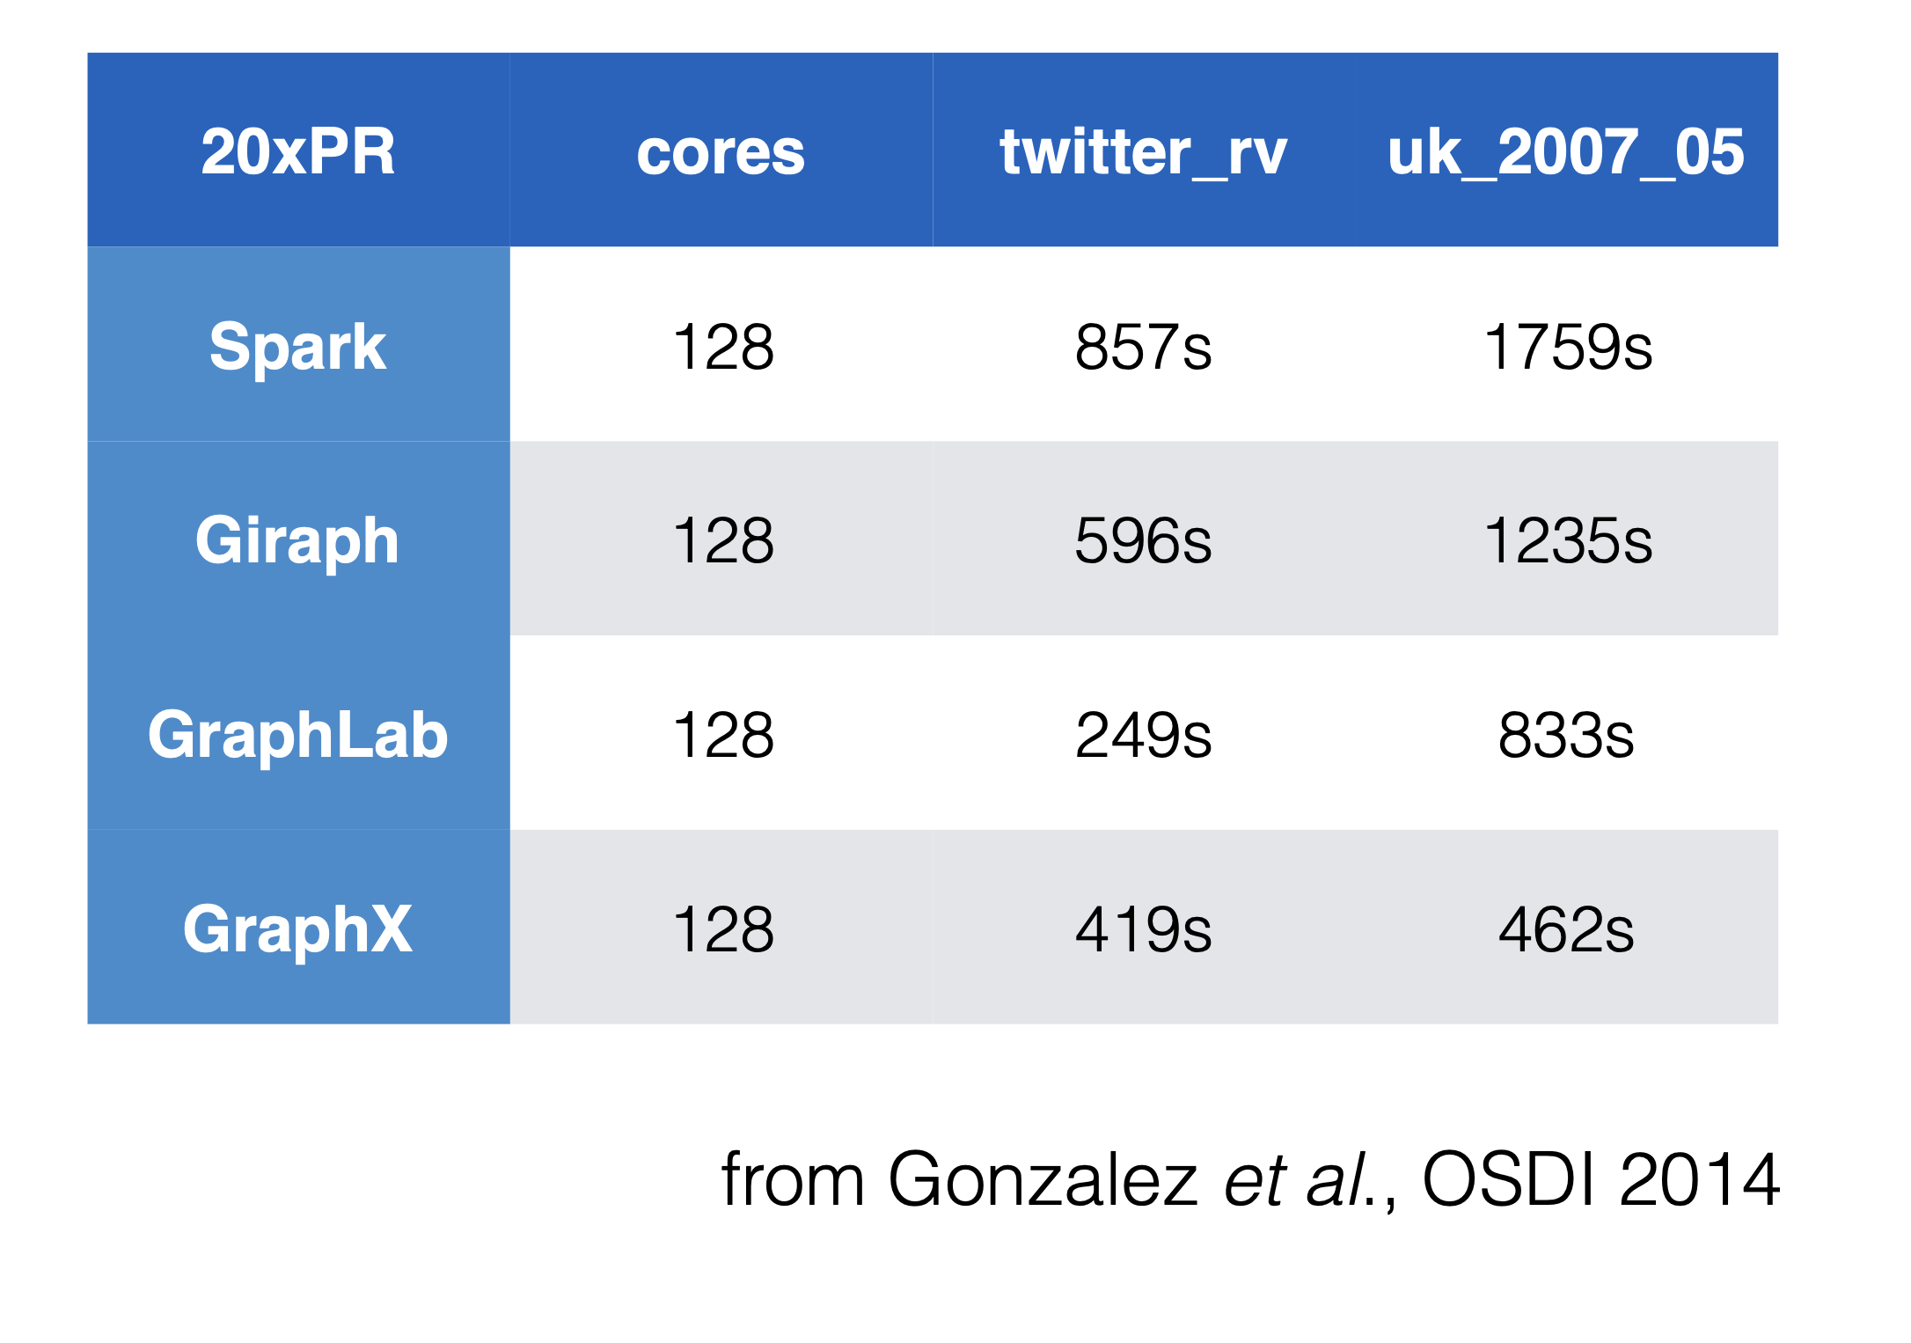
Notes:
Source: powergraph

Slide 22
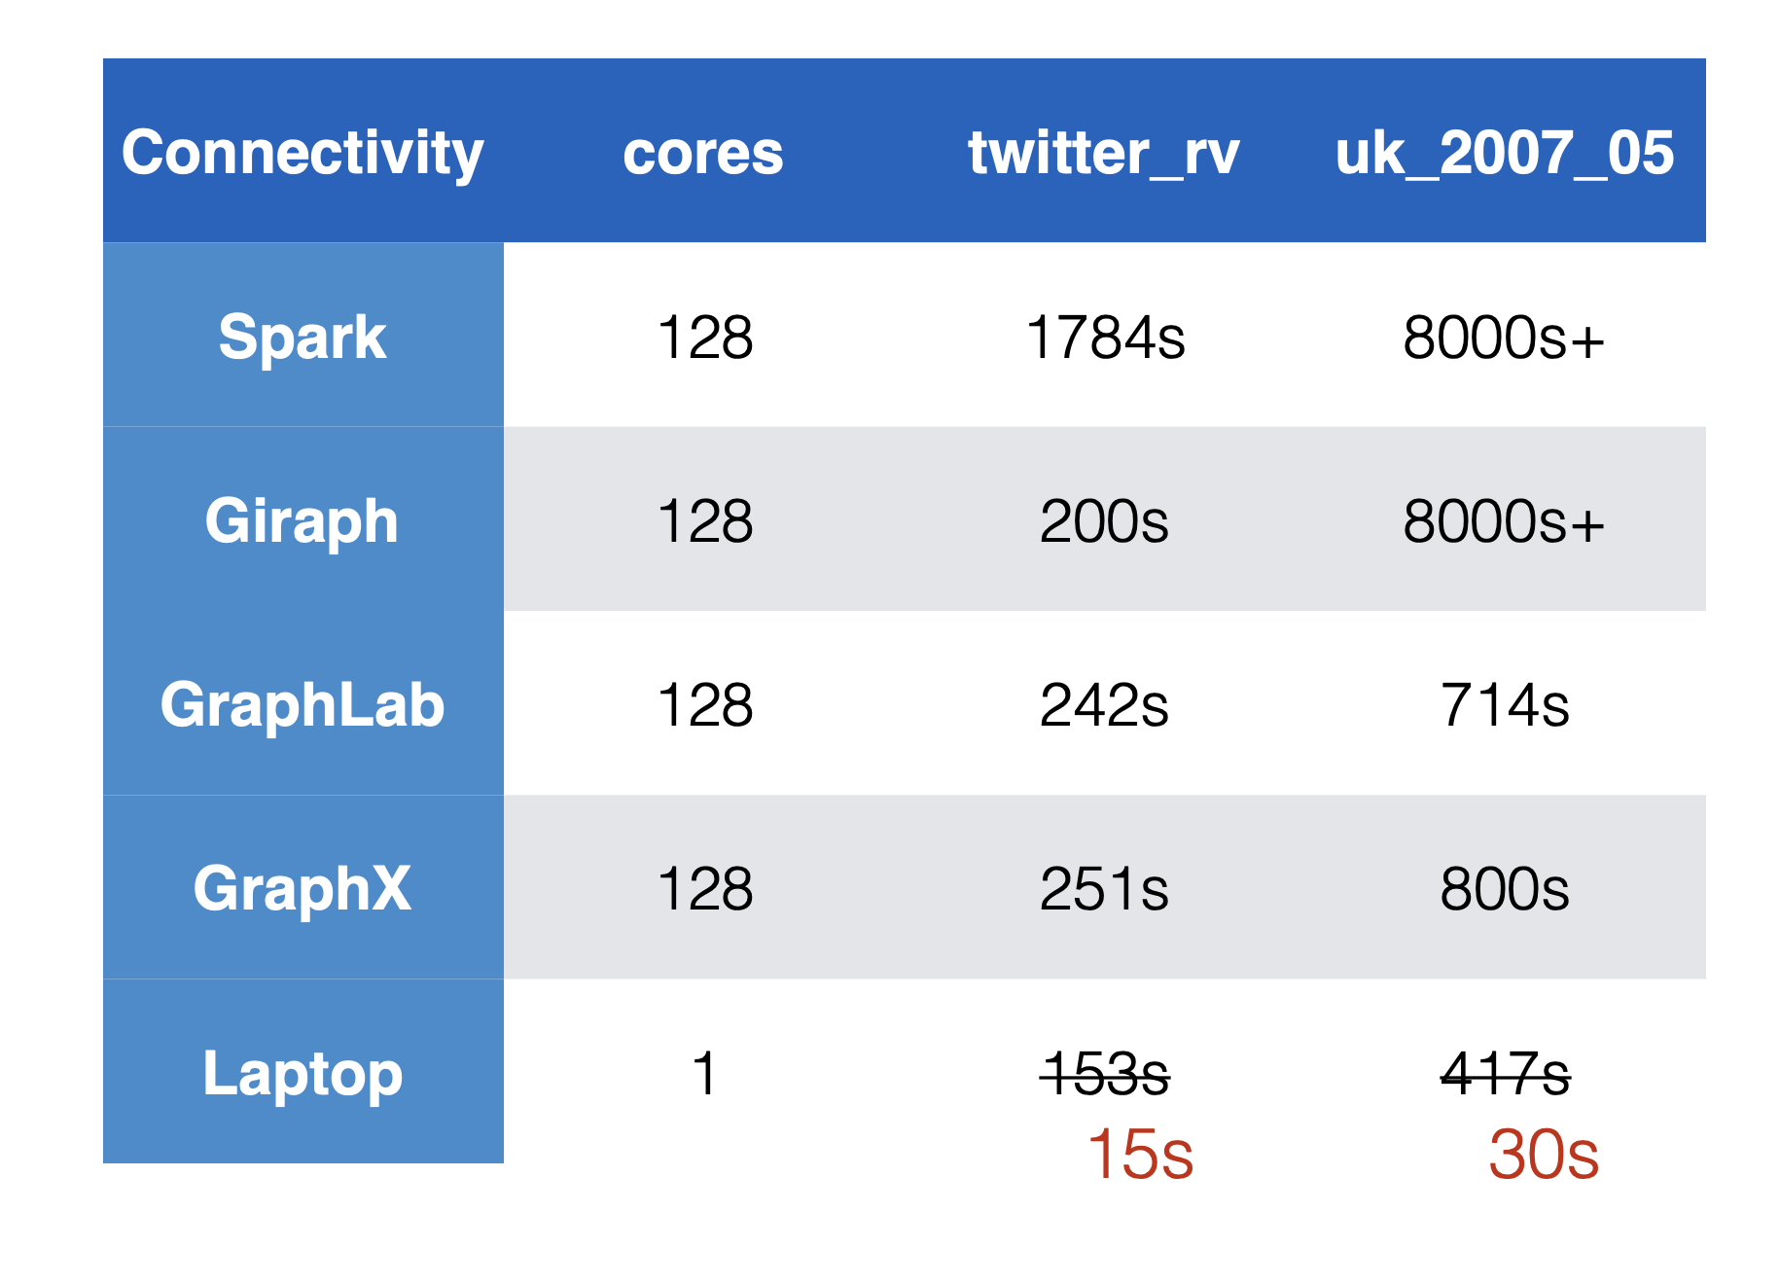

Slide 23
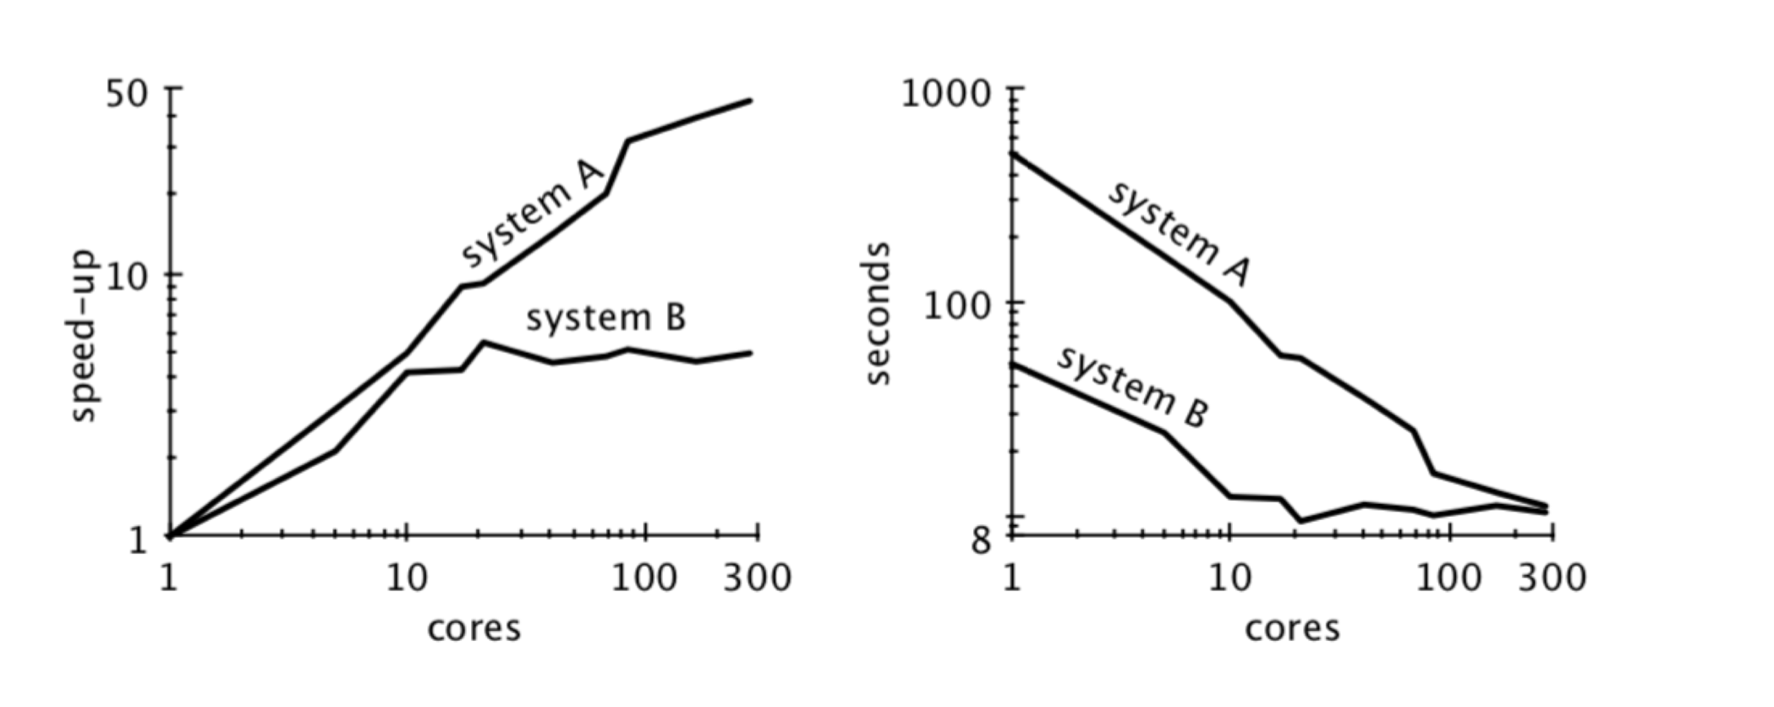
Question: which system is better?

Slide 24
Question: which system is better?

Slide 25
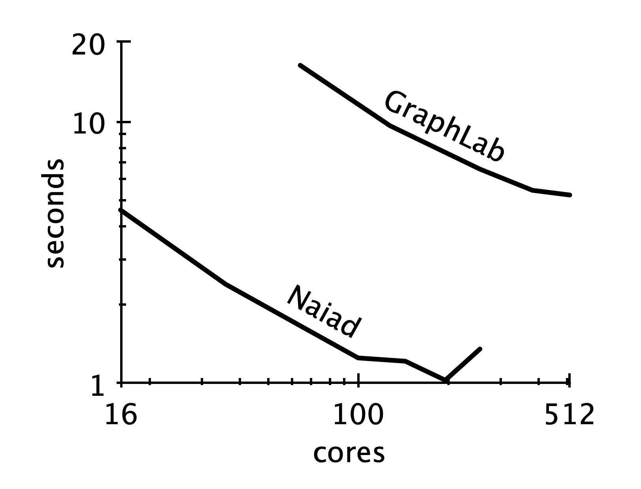
Workload: graph processing

Slide 26
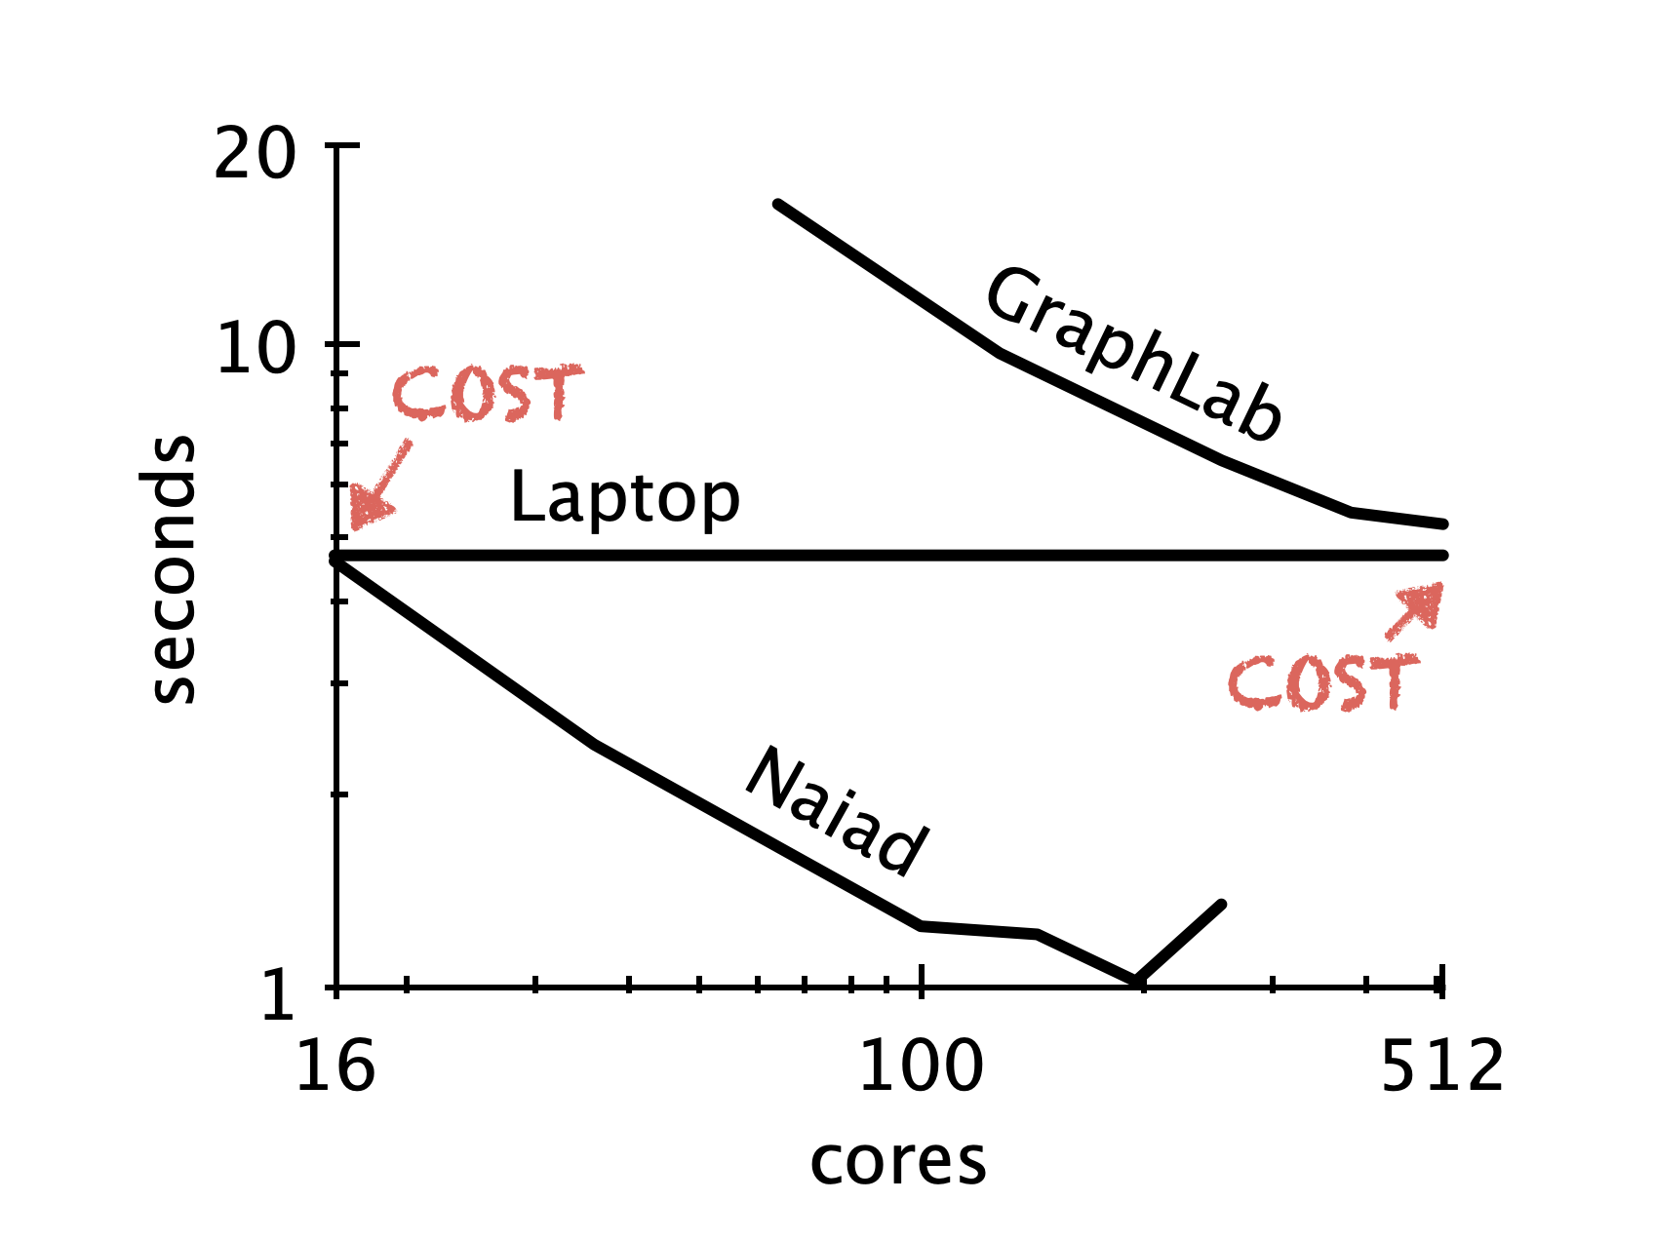
Workload: graph processing

Slide 27
What can go wrong?
Scalability has the cost
  E.g. network communication is much slower than local accesses
  Synchronizations overhead to ensure correctness
  Fault tolerance mechanisms
    Components in a distributed system can easily fail!

Slide 28
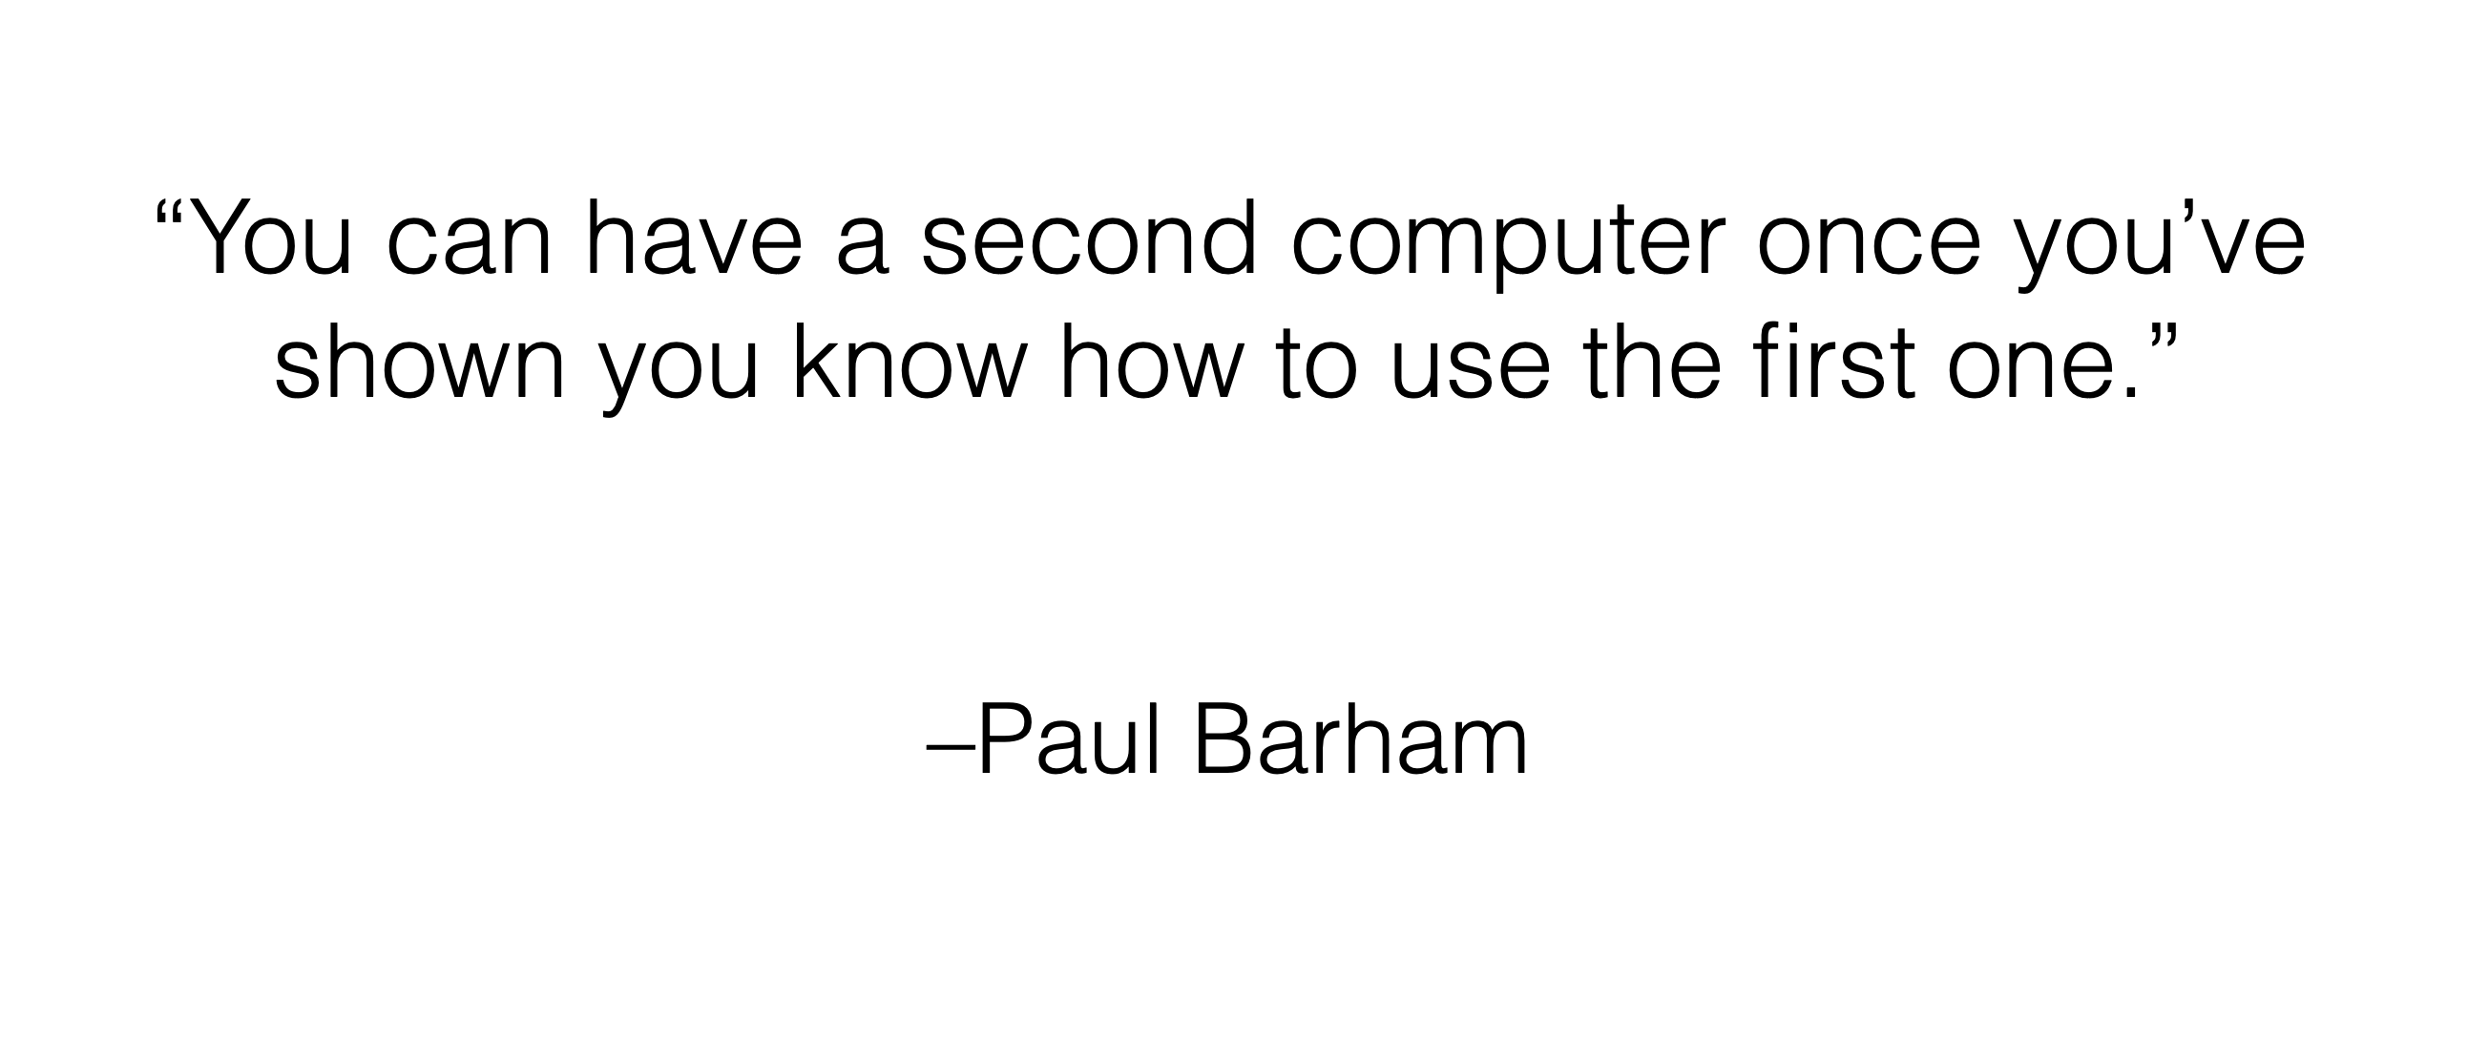
Notes:
Paul barham: tensorflow, pathway

Slide 29
MapReduce cannot address all the issues
MapReduce was used to process webpage data collected by Google’s crawlers
  It would extract the links and metadata needed to search the pages
  Determine the site’s PageRank
The process took around eight hours
  Results were moved to search servers
  This was done continuously
Web
crawlers
MapReduce
Migrate to
search server
~8 hours!

Slide 30
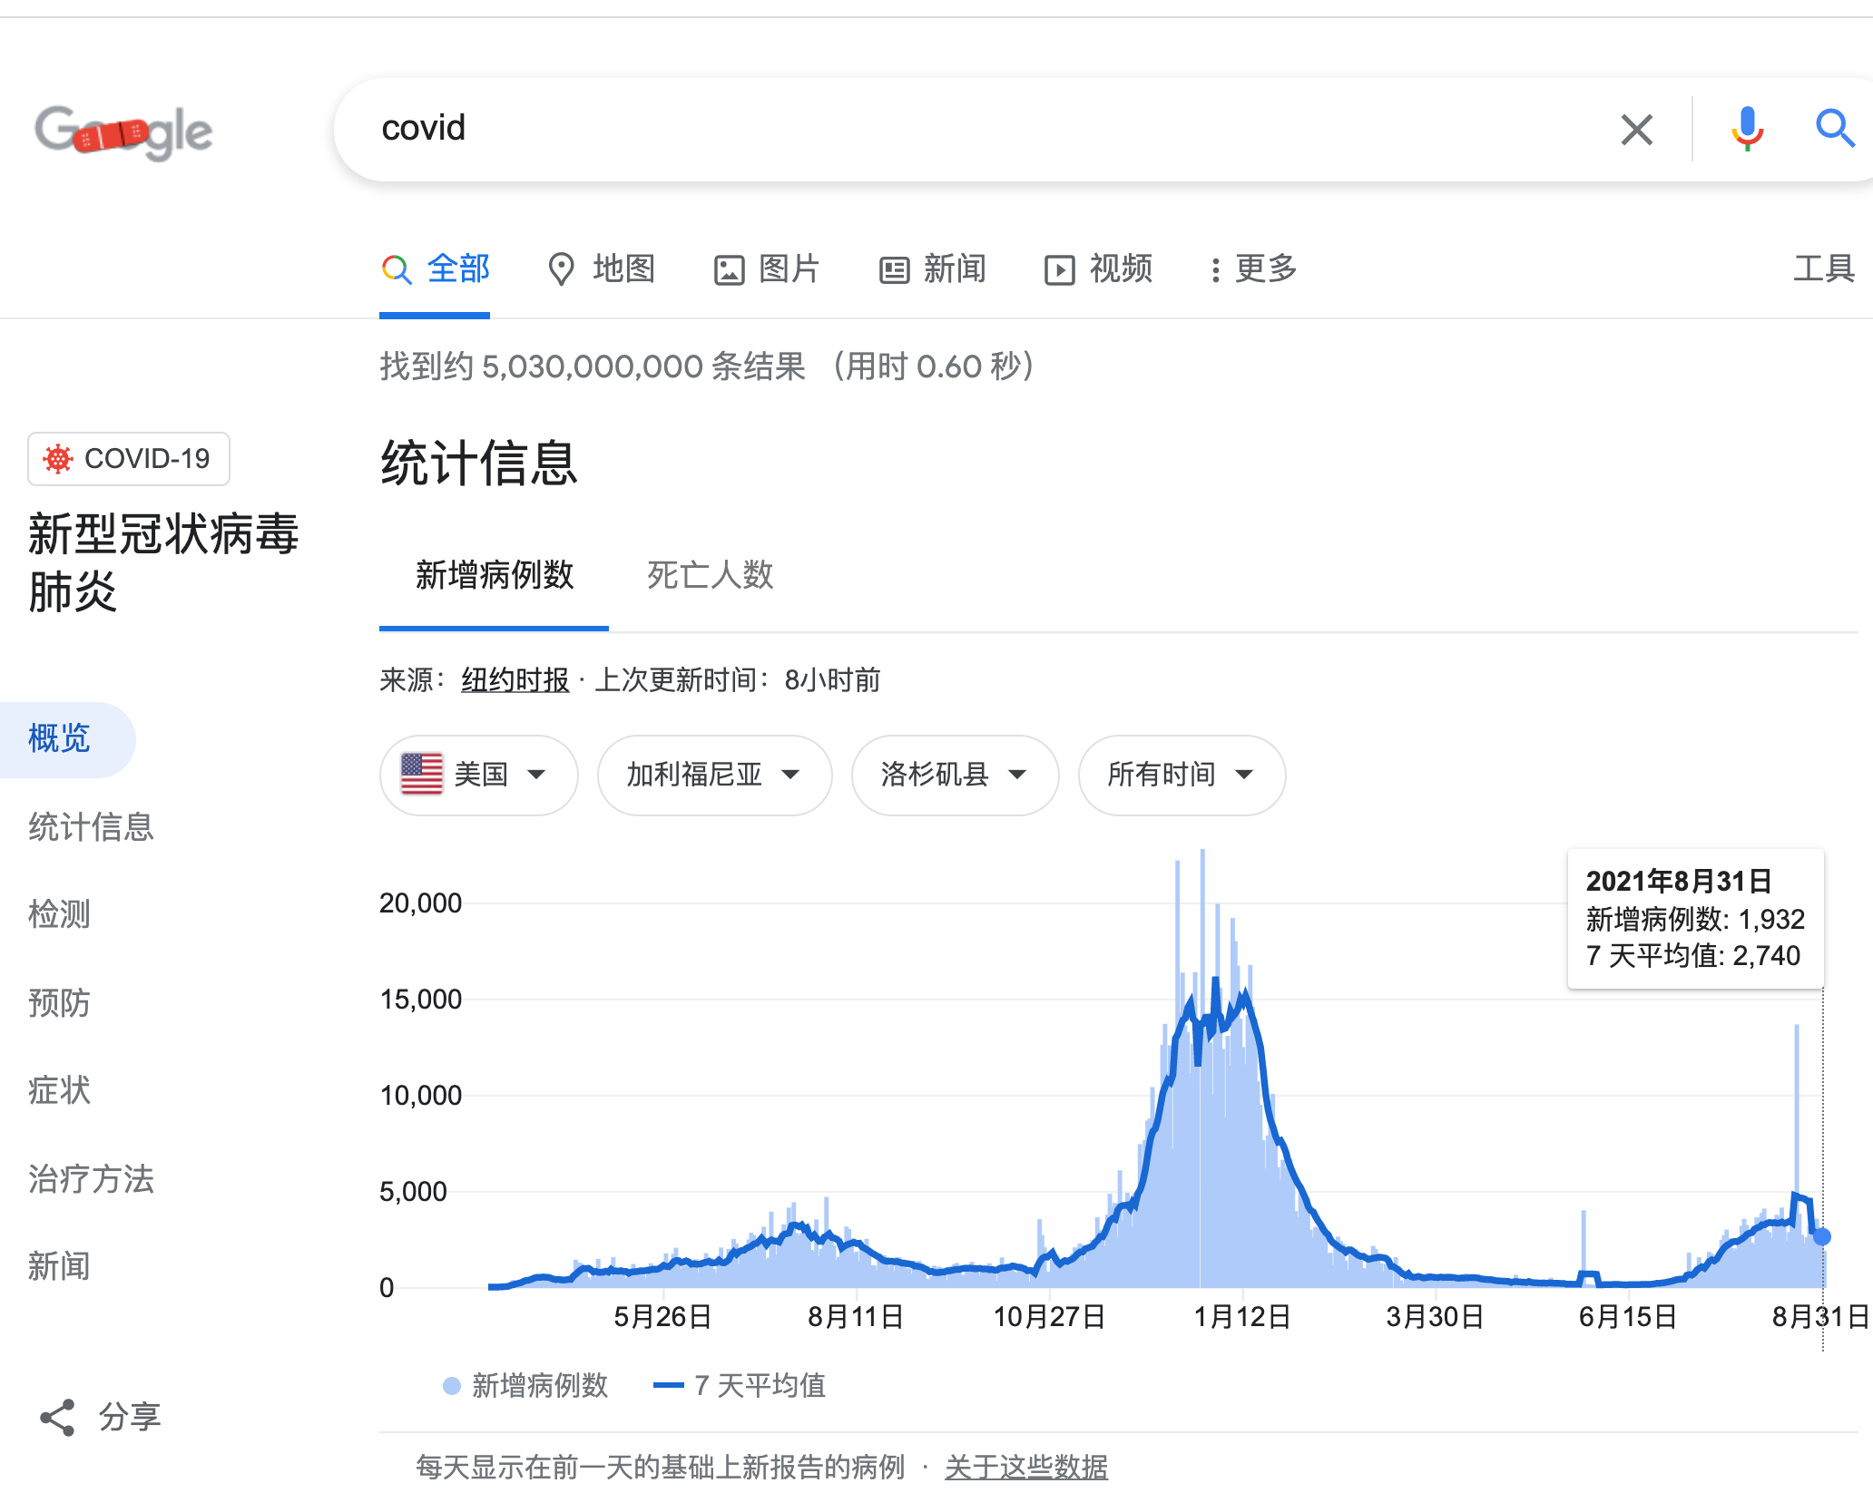
MapReduce cannot address all the issues
Web has become more dynamic
  An 8+ hour delay is a lot for some sites
Goal: refresh certain pages within seconds
MapReduce
  Batch-oriented
  Huge performance overhead
  Not suited for near-real-time processes
  Cannot start a new phase util previous completed
  Not optimized for specific tasks (e.g., Graph, ML)

Slide 31




MapReduce cannot address all the issues
Time
Graph
Graph analytics frameworks
MapReduce
Machine
Learning
…
Machine learning
frameworks
Caffeine
Search
Engine
Google’s new search
engine

Slide 32
Restrictiveness of MapReduce Programming Model
Question#1
  How can we use MapReduce to implement “find the five most popular pages”?
Hint:
  We can chain multiple MapReduce tasks together

Slide 33
Restrictiveness of MapReduce Programming Model
Question#2:
  Is chaining multiple MapReduce tasks a good solution?
    E.g., programming is not easy
    Fault tolerance of multiple map-reduce tasks is not supported, should be handled by the users
    Performance cost due to chaining

Slide 34
Performance issues of multiple-sages execution
MapReduce runtime is not optimized for iteration
  Persistent I/O (e.g., GFS)
. . .
Awk
sort
Time
Data
Data
Map
Reduce
Map
Reduce
Data
Data
Data
Map
Reduce
Map
Reduce
Startup Penalty
Disk Penalty
Startup Penalty
Disk Penalty
Data
Data
Map
Reduce
Data
Data
Data
Map
Reduce
Map
Reduce
Data

Slide 35
From MapReduce to DAG (Computation graph)

Slide 36
The computation graph abstraction
Computations are expressed as a graph (Directly acrylic graph)
  Vertices are computations (or data)
  Edges are communication channels
  Each vertex has several input and output edges
Outputs
Processing
Vertices
Channels
(file, pipe, memory)
Inputs

Slide 37
Dataflow graph can support a wide-range of jobs
Distributed computing Job = Directed Acyclic Graph (DAG)
Back to our log analysis example
…
sort
data0
data1
data2
awk
access.log.0
access.log.1

Slide 38
A typical DAG runtime
Vertices (V) run arbitrary app code, exchange data through
TCP pipes etc., and communicate with JM to report status
Job Schedule
Data Plane
Files FIFO Network
V
V
V
JM
NS
D
D
D
Control Plane

Slide 39
A typical DAG runtime
Job Manager (JM) consults name server (NS) to discover available nodes, and maintains job graph and schedules vertices
Job Schedule
Data Plane
Files FIFO Network
V
V
V
JM
NS
D
D
D
Control Plane
39

Slide 40
A typical DAG runtime
Daemon process (D) executes vertices
Job Schedule
Data Plane
Files FIFO Network
V
V
V
JM
NS
D
D
D
Control Plane

Slide 41
Scheduling in job manager
General scheduling rules
  Vertex can run anywhere once all its inputs are ready
    Prefer executing a vertex near its inputs (locality)
Fault tolerance
  Vertex fails → run it again
  Vertex’s inputs are gone → run upstream vertices again (recursively)
  Vertex is slow → run another copy elsewhere and use output from whichever finishes first
What if the vertex execution is non-idempotent？

Slide 42
Dryad proposes the DAG as distributed computing abstraction
Created by Microsoft (EuroSys’07)
  Authors: Michael Isard, Andrew Birrell, et al.
Similar goals as MapReduce
  A general-purpose distributed execution engine for coarse-grain data-parallel applications
  Automatic management of scheduling, distribution, and fault tolerance
But needs application-specific semantic to split the nodes
  Otherwise, the graph fallback to a chain, so there is no parallelism
  A little harder than MapReduce, but also hides the distributed execution details

Slide 43
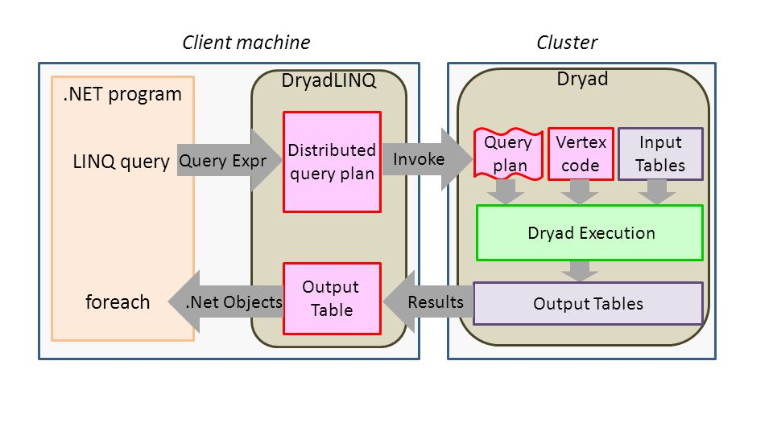
DryadLINQ: Dryad + LINQ (SQL like)
More friendly to traditional data programmers: use LINQ (SQL-like language)
- Hide the generation of a DAG that has high concurrency

Slide 44
Summary
Dryad lets developers easily create large-scale distributed apps without requiring them to master any concurrency techniques beyond being able to draw a graph of the data dependencies of their algorithms. -- Michael Isard
Sacrifice some architectural simplicity compared with MapReduce system design
Provide more flexible abstract to developers expressing their code as a DAG

Slide 45
How to express AI program to distributed framework?
Dataflow graph!

Slide 46
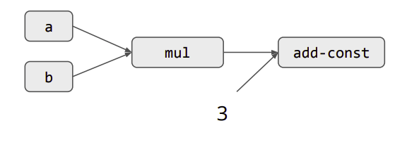
The Language of AI: Computation Graph
Nodes represents the computation (operation)
  E.g., Matrix multiplications, softmax operator, activation functions, variables
Edge represents the data dependency between operations
Example: computational Graph for a * b +3
Notes:
很多其他语言， 但是最后都构造成一个统一抽象：计算图

Slide 47
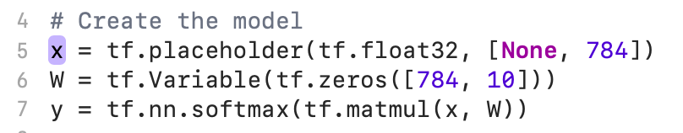
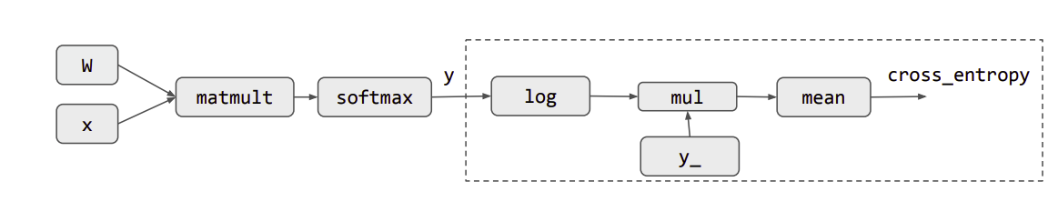
Computational Graph Construction by Step
Example NN: y = softmax(XW) (assuming using Tensorflow-like framework)

Slide 48
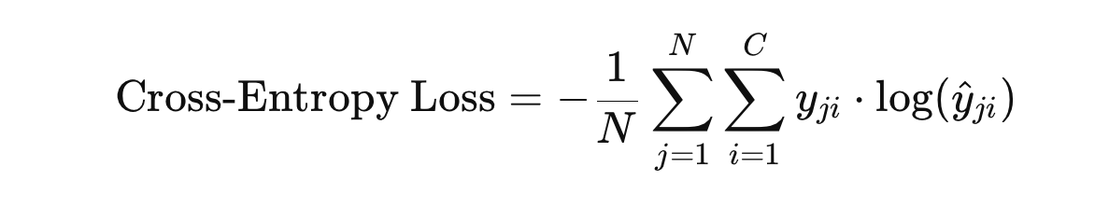
Computational Graph Construction by Step
Cross-entropy loss: #labels (10)

Slide 49
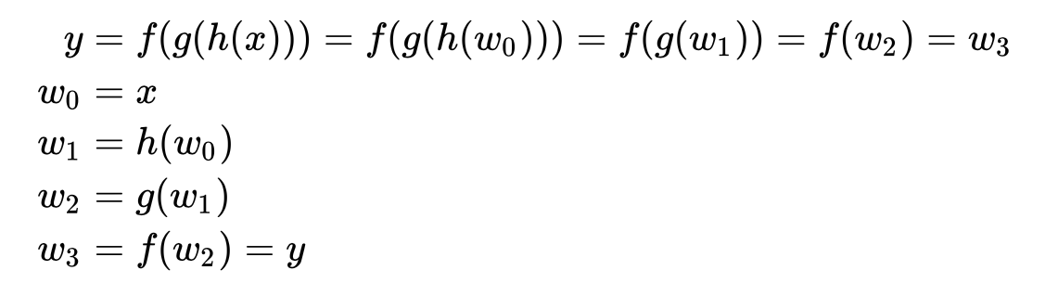
Benefit of computation graph: Automatic Differentiation
Basically, based on the chain rules
w1
w2
x
h
g
f
y
Notes:
https://en.wikipedia.org/wiki/Automatic_differentiation

Slide 50
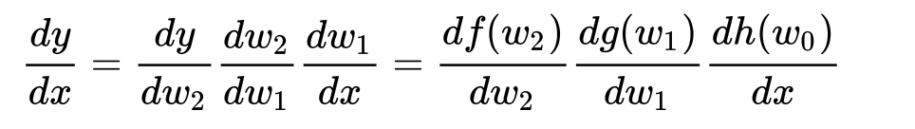
Benefit of computation graph: Automatic Differentiation
Basically, based on the chain rules
So they are called
the backward pass
w1
w2
x
h
g
f
y
dh
dg
df
Notes:
https://en.wikipedia.org/wiki/Automatic_differentiation
There are many other rules
Backward propagation

Slide 51
Benefit of computation graph: Automatic Differentiation
Based on the computation graph, we can easily compute the derivative
  Assumes each operator (node) has a corresponding derivative implementation
  We can trivially combine them together with the chain rule

Slide 52
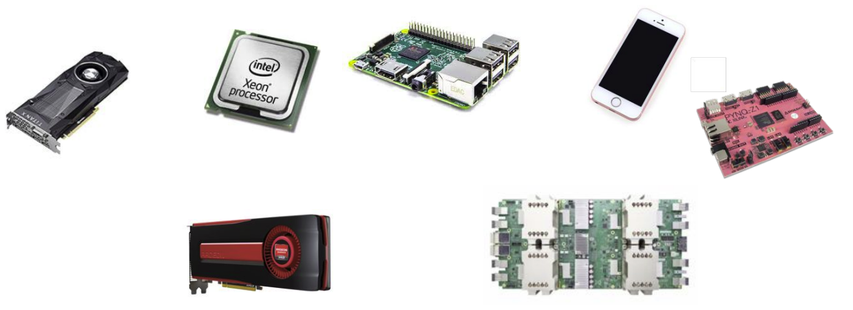
Another benefit: tame heterogeneous hardware
Hardware accelerators to accelerate AI computations
  E.g., GPU, TPU, NPU
  Non-trivial to program! (Recall the previous lecture, e.g., CUDA)
What we have an operator implemented in a specific hardware?
  Can trivially run our computation graph on these hardware
    E.g., using a compiler such as TVM

Slide 53
One thing to note: graph fusion
We can fuse multiple graph nodes to form a larger node
  Benefit: reduce communications
    Both internal (within a device) & cross-node (distributed)
w
Softmax-matmult
Cross_entropy
x

Slide 54
Distributed training

Slide 55
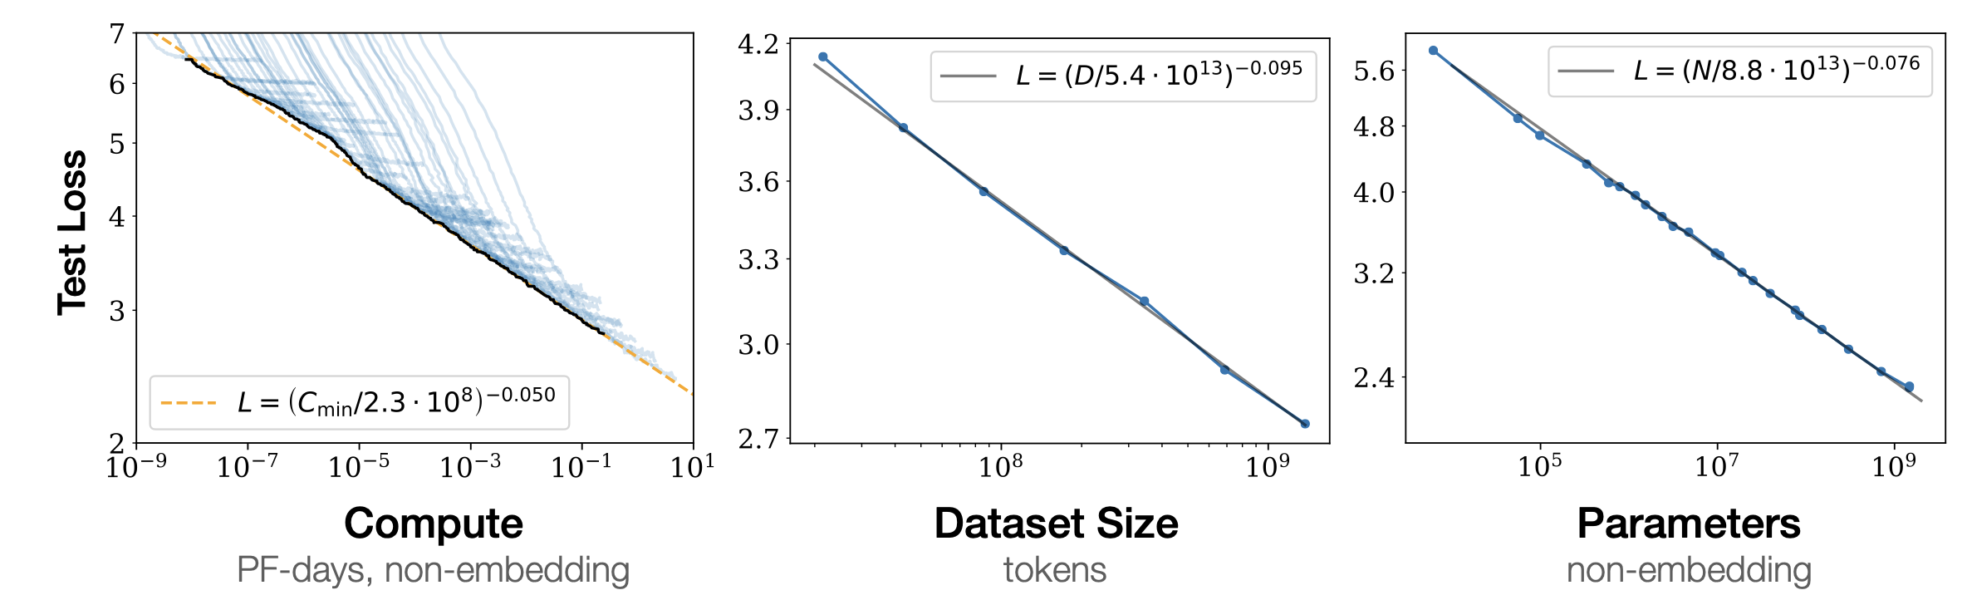
Why we need distributed training? Scaling low
Massive data needed (the larger, the better)
Massive model needed (the larger, the better)
Massive computation power needed

Slide 56
Ideal Metric of Success for Efficient Training
“Learning”
Second
“Learning”
Record
Record
Second
=
x
Convergence
Machine Learning
Property
Throughput
System
Property

Slide 57
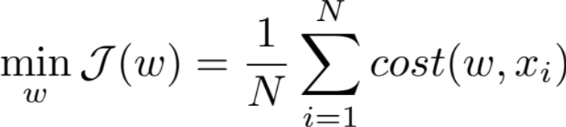
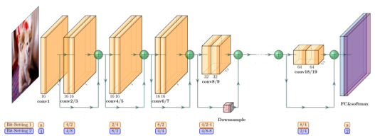
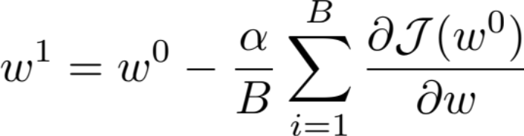
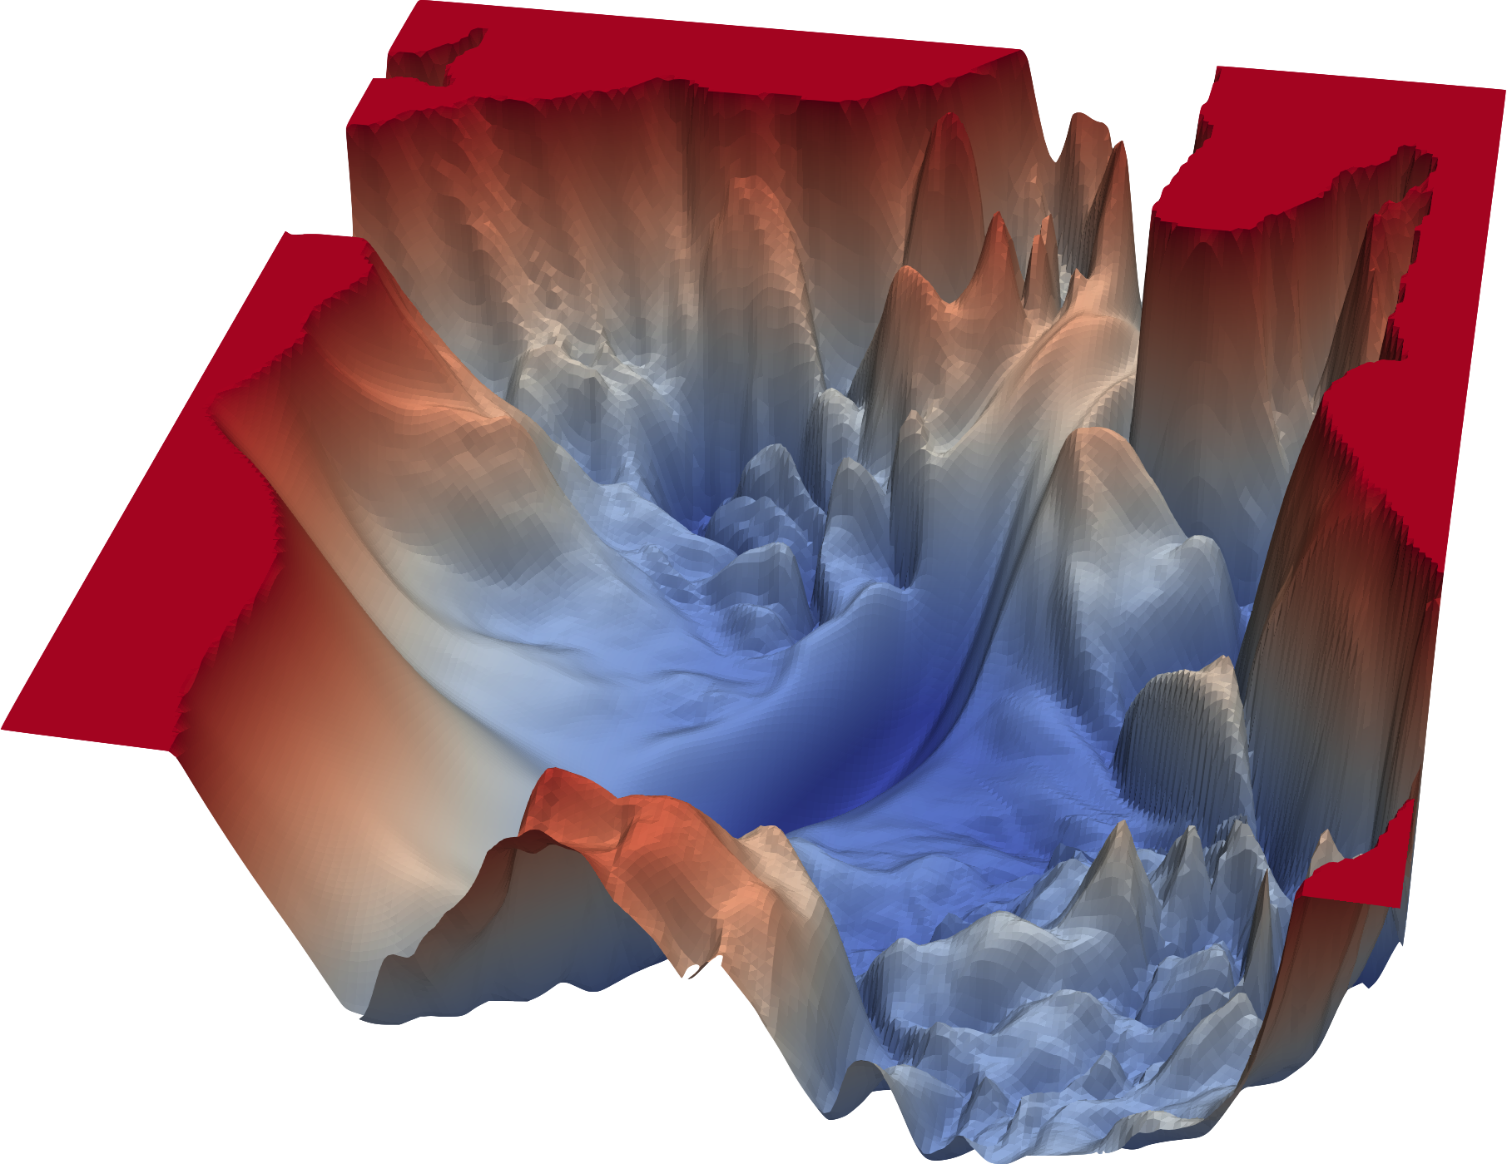

Review: Stochastic Gradient Descent
Learning rate
Two key elements:
The computed gradient: the direction
The learning rate: how big a step do we take?

Slide 58
Stochastic Gradient Descent into computation graph
X: input features
Y: labels in supervised learning
x
y
w
Forward
Backward
Learning rate

Slide 59
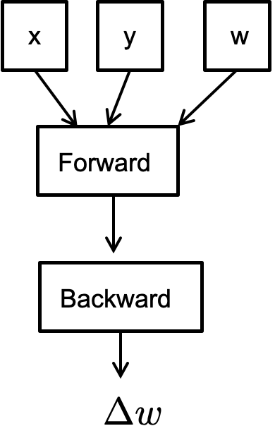
Pseudocode for Stochastic Gradient Descent
// execute on a master
for iter in num_iters:
iter
iter+1
iter

Slide 60

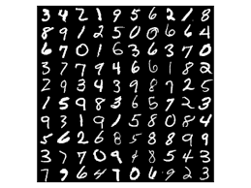

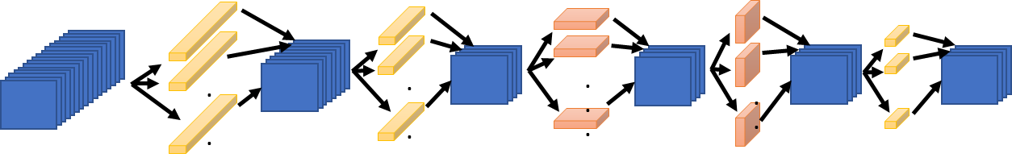
Overview of Stochastic Gradient Descent in action
In every iteration of SGD we load a random mini-batch of training data and compute the gradient.
GPU
Mini-batch (x)
64
fprop
bprop

Slide 61
Parallelization Opportunities
Data Parallelism: Distribute the processing of data to multiple PEs.
Model Parallelism: Break the model and distribute processing of every layer to multiple PEs
For either approach it is also possible to use synchronous or asynchronous updates

Slide 62
(Sync) data parallel

Slide 63
Synchronous Data Parallelism
Parallelize on the x (and y)
  Observation: + can be easily parallelized
X₀
Y₀
X₀
Y₀
w
X₁
Y₁
X₁
Y₁
x
y
w
w
Forward
Forward
Forward
Backward
Backward
Backward
0
1

Slide 64
Synchronous Data Parallelism
X₀
Y₀
w
X₁
Y₁
w
Forward
Forward
Backward
Backward
Sum
0
1

Slide 65
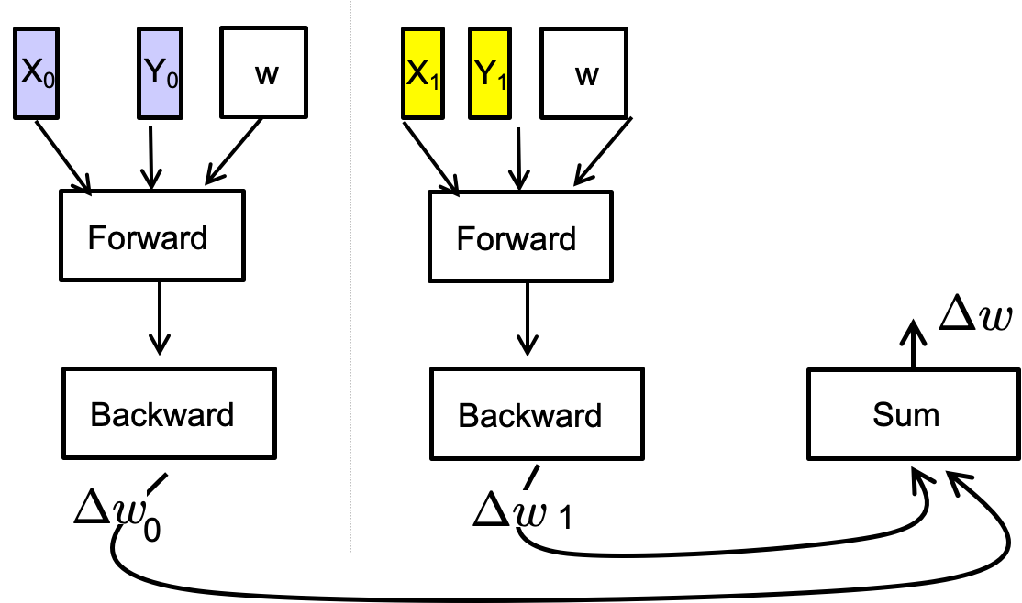
Pseudocode for (iterative) data parallel in action
// execute on a master
for iter in num_iters:
iter
iter+1
iter
The master will do the coordination
  Similar to the Job manager in Dryad

Slide 66

Synchronous Data Parallelism w/ BSP
1024
Store the entire model (W) on each processor
  Then distribute the batch evenly across each processor
  E.g., 64 images per GPU
Question: how to coordinate between iterations?
GPU 1
GPU 2
GPU 3
GPU 16
64
64
64
64
fprop
fprop
fprop
fprop
…
bprop
bprop
bprop
bprop
Communicating & syncing gradients

Slide 67
How to parallelize the partitioned graphs? BSP
Bulk Synchronous Parallel (BSP) Execution
  Using a strict barrier to coordinator processes in a distributed computing
  Barrier can be implemented in a centralized way (master) or decentralized
Compute
Communicate
Compute
Machine 1
Iteration
Iteration
Machine 2
Iteration
Iteration
Machine 3
Iteration
Iteration
Barrier
Barrier

Slide 68
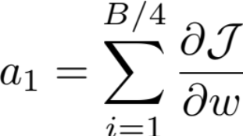
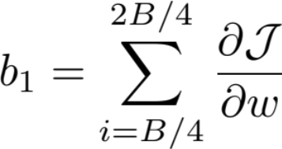
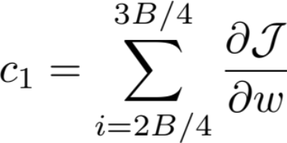
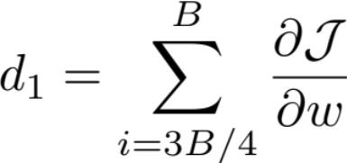
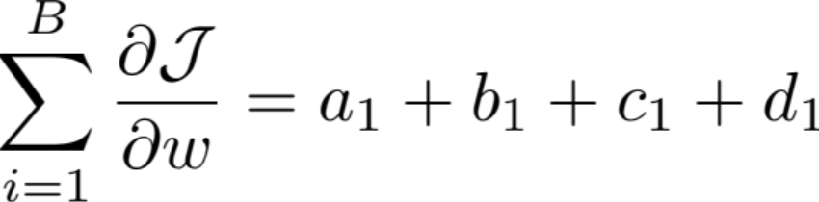
Key operator: allreduce
GPU 1
GPU 2
GPU 3
GPU 4
ALLREDUCE

Slide 69

Communication primitives in distributed computing
Gather: Collect data from all the other processes
  Example: [1][2][3][4] -> (gather) -> [1,2,3,4]
Reduce: Gather and aggregate a piece of data from all the other processes
  Example: [1][2][3][4] -> (reduce) -> [1+2+3+4] = [10]
Data
0
1
2
3
0
1
2
3
Time
0
Time
0
Gather vs. Reduce

Slide 70
Communication primitives in distributed computing
Reduce: Gather and aggregate a piece of data from all the other processes
  Example: [1][2][3][4] -> (reduce) -> [1+2+3+4] = [10]
Allreduce = reduce on all processes
Question: how to efficiently implement allreduce?
0
1
2
3
0
1
2
3
Time
0
0
1
2
3
Reduce vs. AllReduce
* The messages of allreduce may be missing due to space limitations

Slide 71
System requirements for AllReduce
Overhead analysis: computation + network
The overhead of computation is typically small
  Compute a sum operation on device is highly optimized,
  e.g., SIMD, GPU, TPU, etc.
Goal: reduce network overhead
  Reduce bytes sent per-message
  Reduce concurrent messages sent to a server

Slide 72
Try #1: parameter server
Each process pushes the data to the parameter server (PS)
After receiving all data, aggregate the data at the PS
3. The PS pushes the data back to the processes
+
=
PS
0
1
Step #1
Step #2
Step #3

Slide 73
Allreduce with a single parameter server (PS)
Question: what is the network requirements at each stage?
  Step #1: O(1) at each process, O(n) at the PS
  Step #3: O(1) at each process, O(n) at the PS
+
=
PS
0
1
Step #1
Step #2
Step #3

Slide 74
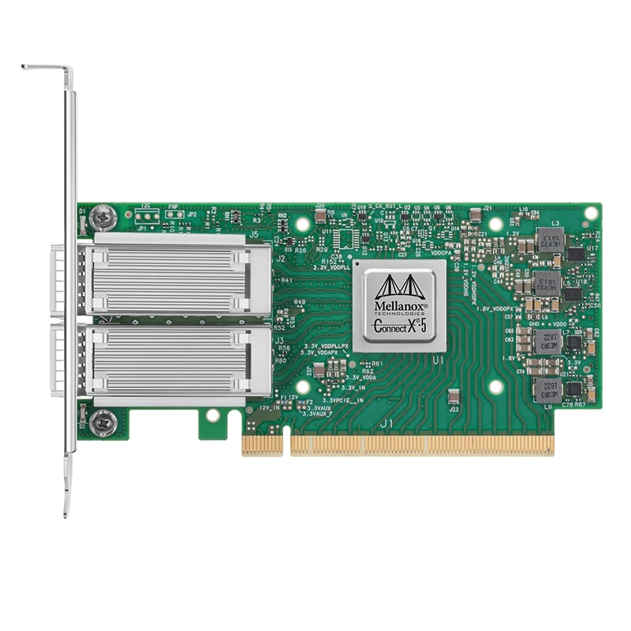
Allreduce with a single parameter server (PS)
Problem: huge bandwidth requirement at the PS (O(P * N))
  As well as huge contention at the master machine
Example: training ResNET50 on V100
  ResNET50: 24.4 M params ~= 97.5MB storage
  On V100, each node can train 3 iterations / second (forward + backward path), w/o communication
  #Processing Node: 256
  Total requirement bandwidth: 256 * 3 * 97.5 = 73.1GB/s
The state-of-the-art NIC: 400Gbps RDMA ~= 50GB/s
  The network would become the bottleneck!
Goal: reduce messages send to a centralized server

Slide 75
Try #2: De-centralized approach for allreduce
Each node finishes its allreduce, one-by-one
  E.g., with a careful designed scheduler
0
1
…
2
3

Slide 76
Analysis of the naïve decentralized reduce
N: total parameters, P: # processors
Total communication per-machine
  N * (P – 1) data (Bad …)
  O(1) fan-in (Good!)
Total communication rounds: O(P * P)
  Much higher than the parameter server approach (O(1))
Question
  Can we do better?

Slide 77
Try#2: De-centralized approach for allreduce
Each node finishes its allreduce, one-by-one
  Observation: communications from future rounds can be moved earlier if w/o contention
0
…
1
2
3

Slide 78
De-centralized approach for allreduce
Each node finishes its allreduce, one-by-one
  Communications from future rounds can be moved earlier if w/o contention
+
+
+
0
1
+
+
+
2
+
+
+
3
+
+
+

Slide 79
Analysis of the naïve decentralized reduce
N: total parameters, P: # processors
Total communication per-machine
  N * (P – 1) data (Bad …)
  O(1) fan-in (Good!)
Total communication rounds: O(P * P) =》 O(P)
  Higher than the parameter server approach (O(1)) , but w/o contention
Question
  Can we do better?
Goal: reduce the payload sent per-process

Slide 80
Idea: partition the data to reduce traffic
Redundant computations
Each node finishes its (a partition of its) allreduce, one-by-one
  Finally, using a decentralized approach to gather all the data
+
+
+
0
1
+
+
+
2
+
+
+
3
+
+
+

Slide 81
Try #3: Ring allreduce
Decentralized reduce, each process reduce on a partitioned data (prev/next to it)
  i.e., each process send one partition data sequentially
0 1 2 3
0
1
0
2
1
3
2
1
2
3
0
2
3
0
1
3
81

Slide 82
Ring allreduce
After the individual reduce, each process can scatter to collect results
  Eventually, all the processes will have the same reduced data
Question: different partition has a different reduce order, does it ok?
0
1
2
3

Slide 83
Why ring allreduce can work?
Assumption: reduce op is associative & communicative
  So we can reorder them to reduce sudden loads at a node
  E.g., we don’t need to collect all the data to do the reduce
Otherwise, we cannot reorder the computation

Slide 84
Analysis of the communication cost of ring allreduce
N: total parameters, P: # processors
Total communication per-machine
  2 * (P-1) * N / P: the same as partitioned
  O(1) fan-in
Total communication rounds: O(P)
  Much higher than the parameter server approach (O(1))
  A trade-off for reducing network contention due to high fan-in
What are the drawback?
  High latency due to extra round

Slide 85
Allreduce: put it all together
Trade-off between rounds vs. fan-in performance
 | Round | Peak node bandwidth | Per-node fan-in
Parameter server (PS) | O(1) | O(N * P) | O(P)
Decentralized Allreduce | O(P) | O(N) | O(1)
Ring allreduce | O(2 * P) | O(N/P) | O(1)

Slide 86
More reduce methods exist
Key design goals
  Reduce payload sent per-node
  Reduce fan-in to avoid contention on network resource
  (new) Reduce rounds (grow linearly w/ the number of processors)
  (new) Better suits the underlying hardware (Cloud & HPC)
Still an active research field
  E.g., what if the hardware speed between different machines diff?
  What if the link speed changes overtime?

Slide 87
Case study: NVLink + RDMA
Setup
  Each machine has multiple GPUs for computation
  These GPUs essentially form a distributed (processing) system
NVLink
  Fast interconnects that connect different GPUs
RDMA
  Fast networking feature that connects different machines

Slide 88
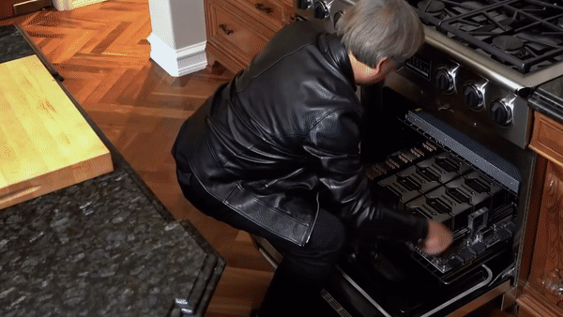
What does NVLink Look Like?
8-GPU on single board

Slide 89
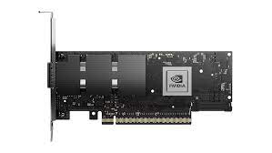
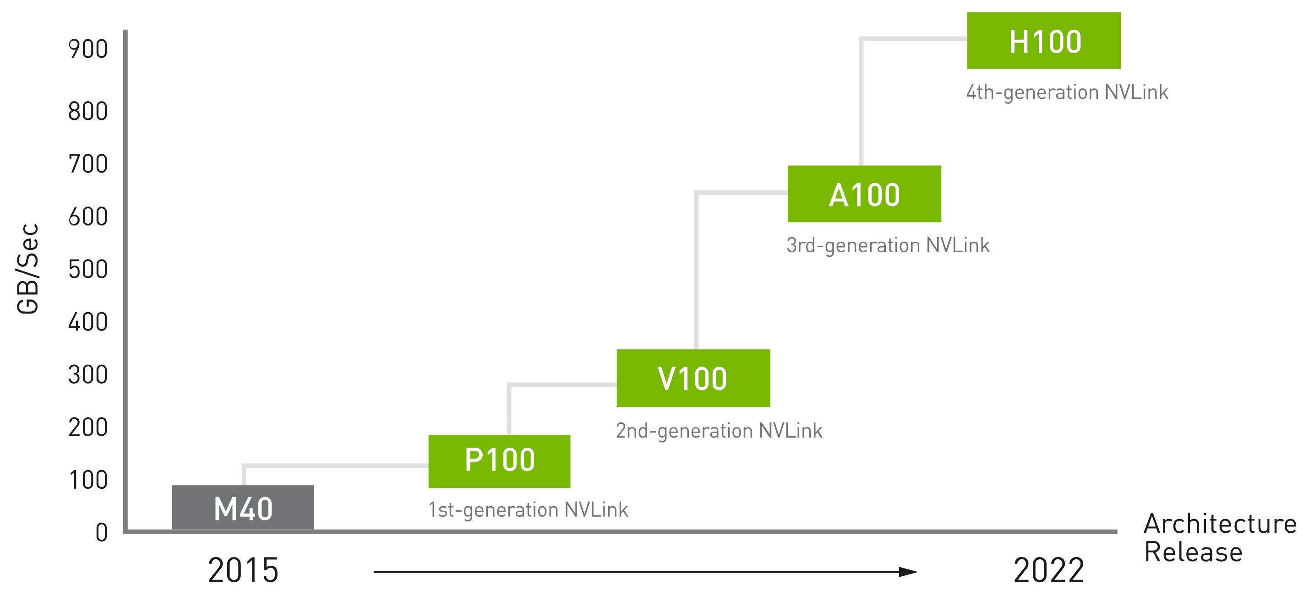
Why is NVLink Fast?
Massive Parallelism (thanks to the close placement of hardware)
  GPUs are connected w/ multiple lanes, w/ high frequencies
18x8 lane (4.0)
12x8 lane (3.0)
6x16 lane (2.0)
4x16 lane
RDMA (2X400Gbps)
Notes:
GPU之间会用很多条NVLink链路连接起来。
这边的x16，x8就类似于PCIe的宽度，前面的4，6，12，18，就是每个GPU上最多可以连几条link。和前面每个lane的带宽乘起来，就能获得最终数百GB的带宽。

Slide 90
Communication heterogeneity
Different nodes’ link capacity differs
  Internode: high bandwidth (e.g., 450GBps)
  Intranode: relative slow bandwidth (e.g., 100GBps)
Optimization opportunities
  We can do a parameter server within a server, and do rings across servers
Server
GPU 0
GPU 2
GPU 0
GPU 2
NVLink
RDMA
NVLink
GPU 1
GPU 3
GPU 1
GPU 3

